Slide 1
What is chatbot and Why is it important?

Slide 2
A chat bot is computer program that is capable of having natural conversations with human often using Artificial intelligence.

Slide 3
Why it is important?
Nearly 80% of companies have already used or planned to use chatbots by 2020
51% of consumers want 24/7 support
Messaging – Most favoured support channel
Can save cost on Sales, Marketing and Customer Services

Slide 4
Procedure to create simple bot
Bot builder SDK and Microsoft Bot Emulator
Language Understanding Intelligent Service(LUIS)
Writing demo Movie Ticket Booking Bot
Deploying the bot in Heroku cloud application platform
Setting up Azure bot service

Slide 5
Bot Builder SDK
Powerful system for building dialogs
Built-in-support for different message types
Built-in-support for NLP services such as LUIS

Slide 6
Prerequisites
Node js
Visual Studio Code
A Microsoft Account
Bot Emulator

Slide 7
LUIS
Machine Learning Based Service
Extracts meaning from user input in natural language
Key concepts
Intents
Utterances
Entities

Slide 8
Utterance
An utterance is text input from the user that your app needs to understand
Utterances aren’t always well formed and can have variations
Examples Variations:
Book me a flight to New York
I had like to book flight to London
Can you book me couple of flight tickets to Denver

Slide 9
Intent
Represents an action or goal. Eg: Book Ticket, Cancel Ticket
Represents sample utterances for the training the model
At least 5 utterance variations per intent
The most utterance variations , the more good for intent recognition

Slide 10
Entity
Represents some information that is relevant in the utterance
For Example :
Book me a flight to New York
Can you book me couple of flight tickets to Denver
Wake me at 5 AM

Slide 11


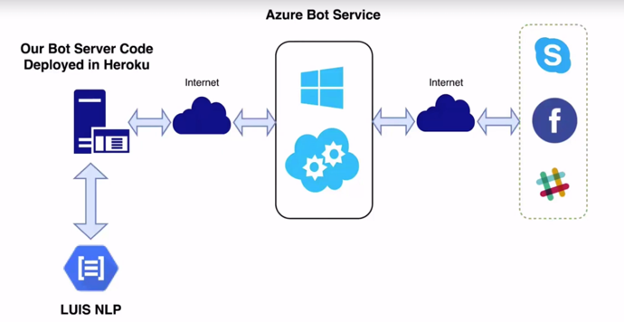




Slide 12
Let’s see the demo

